Slide 1
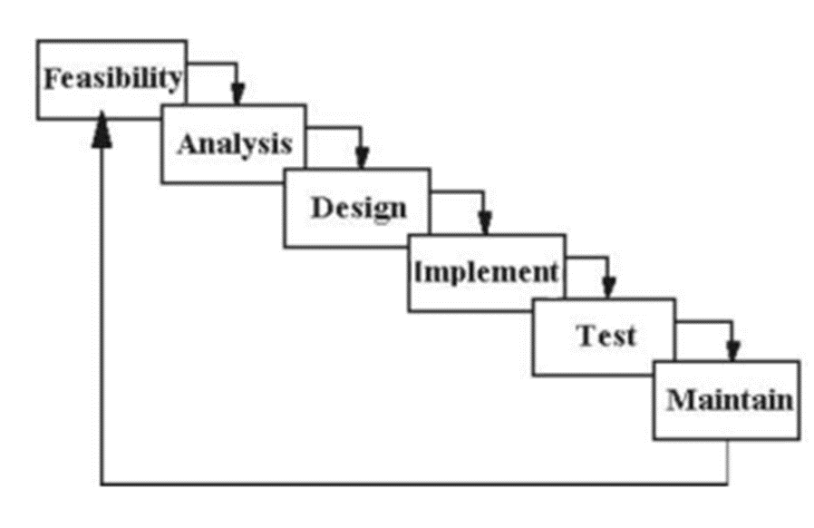
System Development Life Cycle
LECTURE - 8

Slide 2
Overview
The Systems Development Life Cycle (SDLC) is a conceptual model used in project management that describes the stages involved in an information system development project from an initial feasibility study through maintenance of the completed application.
Various SDLC methodologies have been developed to guide the processes involved including :
the waterfall model (the original SDLC method)
rapid application development (RAD)
joint application development (JAD)
the fountain model and the spiral model

Slide 3
WATERFALL MODEL
The Waterfall approach was established in 1970 by Winston w. Royce.
It contains five phases of management, where each requires a deliverable from the previous phase to proceed.
The Waterfall model is the earliest SDLC approach that was used for software development.
linear-sequential life cycle model.
very simple to understand and use. In a waterfall model
Each phase must be completed before the next phase can begin and there is no overlapping in the phases.
The whole process of software development is divided into separate phases.
The outcome of one phase acts as the input for the next phase sequentially.

Slide 4
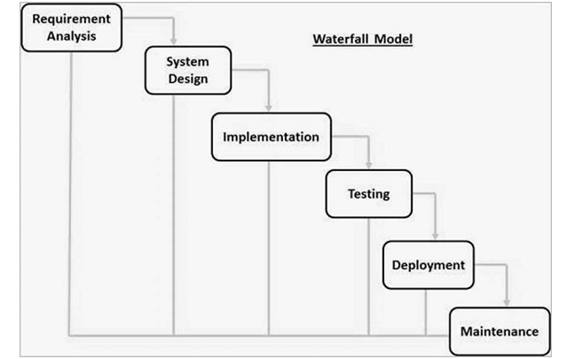

Slide 5
Requirement Gathering and analysis − All possible requirements of the system to be developed are captured in this phase and documented in a requirement specification document.
System Design − The requirement specifications from first phase are studied in this phase and the system design is prepared. This system design helps in specifying hardware and system requirements and helps in defining the overall system architecture.
Implementation − With inputs from the system design, the system is first developed in small programs called units, which are integrated in the next phase. Each unit is developed and tested for its functionality, which is referred to as Unit Testing.

Slide 6
Integration and Testing − All the units developed in the implementation phase are integrated into a system after testing of each unit. Post integration the entire system is tested for any faults and failures.
Deployment of system − Once the functional and non-functional testing is done; the product is deployed in the customer environment or released into the market.
Maintenance − There are some issues which come up in the client environment. To fix those issues, patches are released. Also to enhance the product some better versions are released. Maintenance is done to deliver these changes in the customer environment.

Slide 7
Rapid Application Development
The Rapid Application Development (or RAD) model is based on prototyping and iterative model with no (or less) specific planning.
In general, RAD approach to software development means putting lesser emphasis on planning tasks and more emphasis on development and coming up with a prototype.
It targets at developing software in a short span of time.

Slide 8
Joint application development (JAD)
a methodology that involves the client or end user in the design and development of an application, through a succession of collaborative workshops.
The primary purpose of using JAD in the analysis phase is to collect systems requirements simultaneously from the key people involved with the system.
A JAD is an inexpensive, popular requirements determination technique.
Augments the stakeholders' association in cycles of software development.
Its life cycle has been adopted for areas of the dynamic software development method.
In comparison with the more traditional practice, is thought to lead to faster development times and greater client satisfaction, because the client is involved throughout the development process.

Slide 9
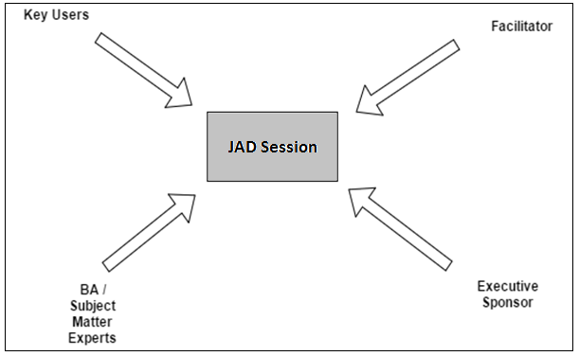
Participants in a JAD Sessions

Slide 10
Executive Sponsor
An executive sponsor is the person who drivers the project ─ the system owner. They normally are from higher positions and are able to make decisions and provide necessary strategy, planning and direction.
Subject Matter Expert
These are the business users and outside experts who are required for a successful workshop. The subject matter experts are the backbone of the JAD session. They will drive the changes.
Facilitator
He chairs the meeting; he identifies issues that can be solved as part of the meeting. The facilitator does not contribute information to the meeting.
Key Users
Key users or also called as super users in some instances have been used interchangeable and differs from company to company still. Key users are generally the business users who are more tightly aligned to the IT project and are responsible for the configuration of profiles of their team members during the projects.

Slide 11
The fountain model
Waterfall is a model that enforces control and avoids parallelism; every requirement for a task has to be fulfilled before starting the task. Fountain says that a new task can be started before all requirements are met, because not all requirements are necessary at the start of the task.
was proposed as a way of representing software development life-cycles that are highly iterative. Even though most processes have a natural sequential flow in, its developmental life cycle, software is one such field where coding can start even before the design is totally mature.

Slide 12
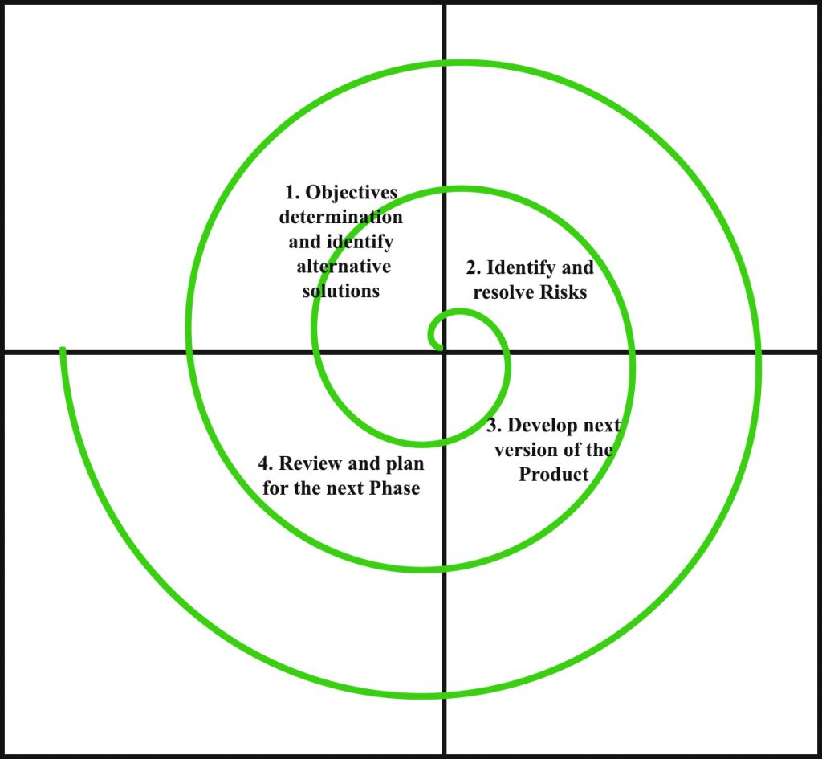
The spiral model

Slide 13
The spiral model is a systems development lifecycle (SDLC) method used for risk management that combines the iterative development process model with elements of the Waterfall model.
The spiral model is used by software engineers and is favored for large, expensive and complicated projects.
It's a risk-driven model which means that the overall success of a project highly depends on the risks analysis phase. Risk analysis requires specific expertise on every iteration.
The spiral model combines the idea of iterative development with the systematic, controlled aspects of the waterfall model. This Spiral model is a combination of iterative development process model and sequential linear development model i.e. the waterfall model with a very high emphasis on risk analysis.

Slide 14
